Slide 1
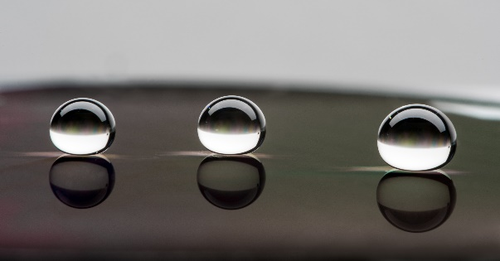
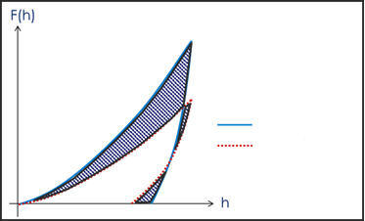
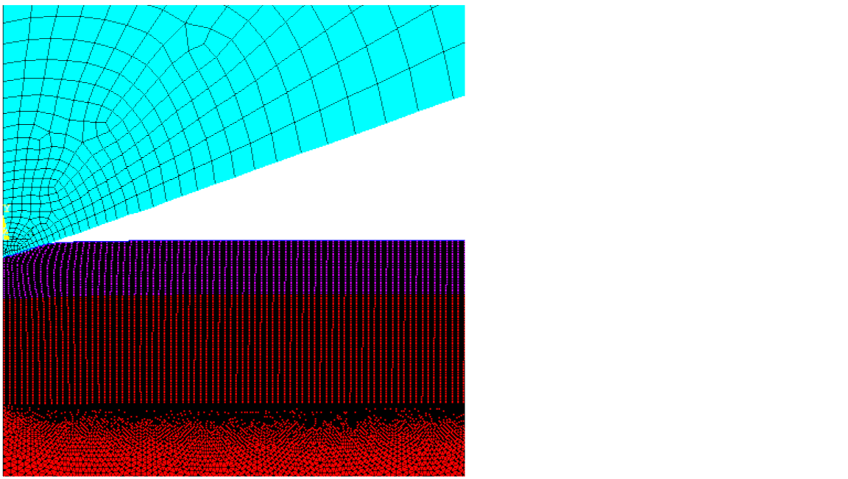
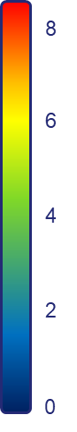
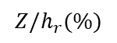
The NANOSTRUCT project focuses on the identification of elastoplastic properties of coated nanostructured optical windows from Berkovich nanoindentation experiments using Finite Element Model Updating (FEMU) method.
These optical windows, such as Ge, Si or glass, can be found on vehicles, ships and soldiers for use in infrared imaging systems, and exhibit combined antireflective and superhydrophobic properties, as a result of patterning nanostructures directly onto the material’s surface. However, it can lead to sub-optimal mechanical properties compared to pristine surfaces. One way to strengthen these optical windows is to deposit a thin hard coating onto the patterns.
In this context, the identification of the elastoplastic properties; elastic modulus E, yield strength σ_{Y} and hardening modulus H; of this film is challenging and furthermore essential for developing the optimal coating and nanostructures geometry.
Photography highlighting the superhydrophobic properties of a nanostructured Si surface
(1)
(2)
SEM image of Al₂O₃ thin film deposited on Ge nanostructures
Minimization of the distance between computed & experimental measurements
Indenter : Diamond
Thin film
Substrate
$$Z/h_{r}(\%)$$
experimental
numerical
Based on a 2D axisymmetric finite element modelled nanoindentation test (2), elastoplastic properties are estimated using Finite Element Model Updating Method (FEMU), by matching load-displacement curves with nanoindentation measurements (1).
By introducing a residual area, related to the indentation pile-up, in the inverse analysis, the parameter identifiability can be improve with a more precise description of the hardening phenomena.

Slide 2
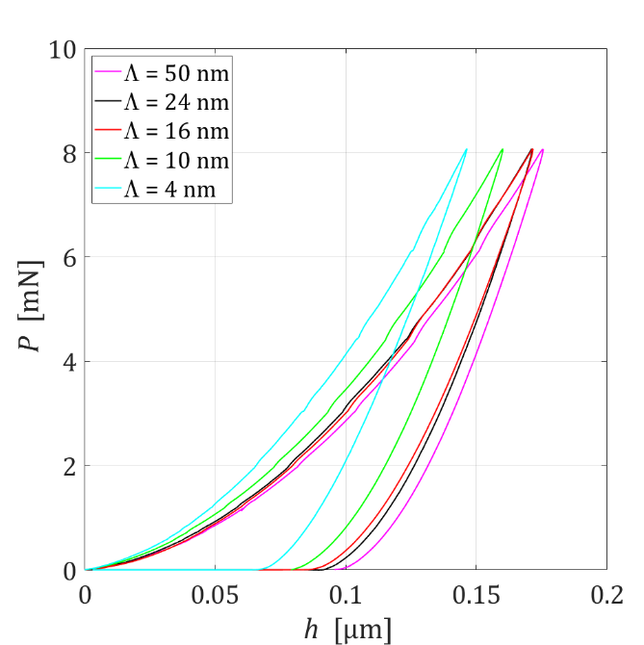
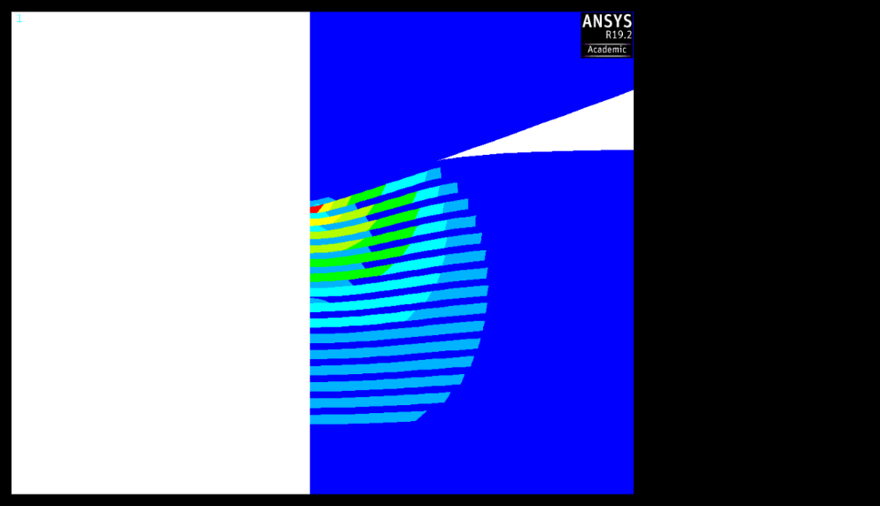
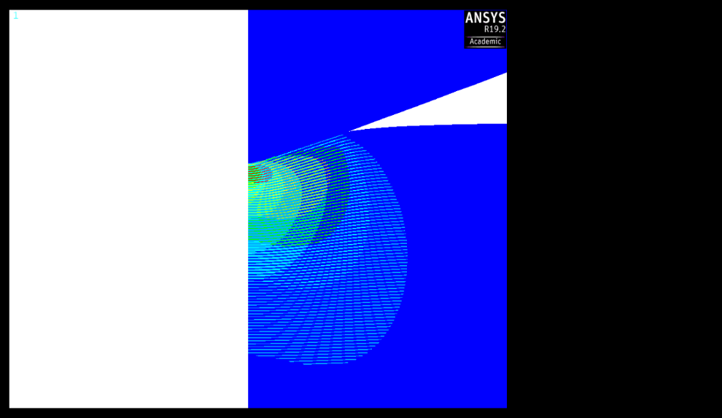
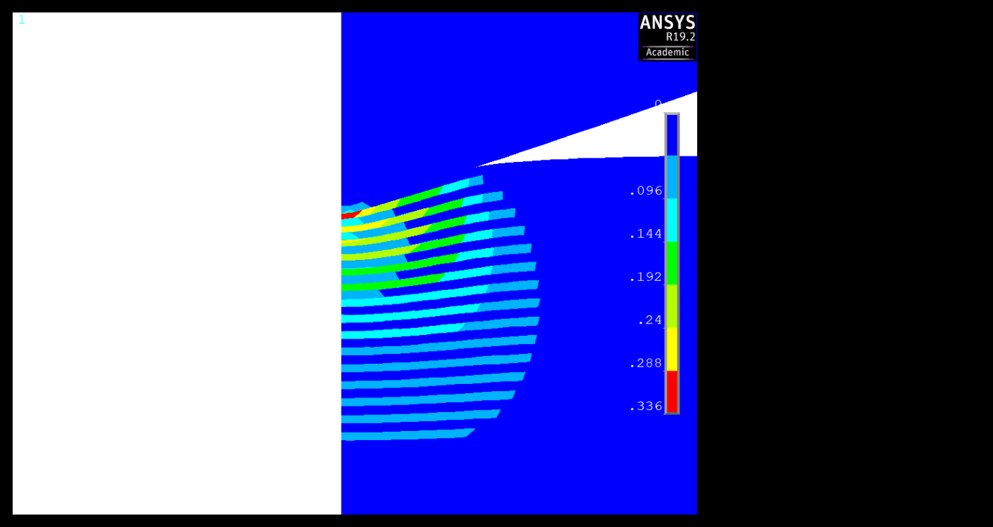

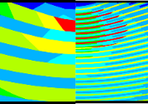
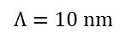
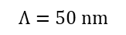
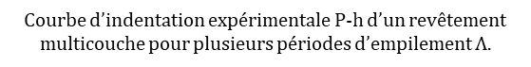
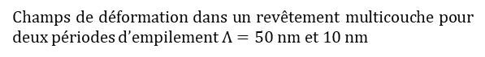
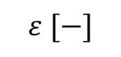
Les 2 objectifs du projet NANOSTRAT :
Modéliser la nanoindentation de revêtements nanostratifiés TiAl/TiAlN afin de comprendre les phénomènes élastoplastiques qui génèrent l’augmentation de la dureté aux plus faibles périodes (effet super-réseau)
Optimiser numériquement la stratification (période, nombre de couches, ...) afin d’obtenir des nanostratifiés TiAl/TiAlN ultra-durs.
$$Λ=50 nm$$
$$Λ=10 nm$$
0.336
Augmentation de la dureté
0.288
0.240
0.192
0.144
0.096
0.048
100 nm
0.000
$$ε [−]$$
Courbe d’indentation expérimentale P-h d’un revêtement multicouche pour plusieurs périodes d’empilement $Λ$.
Champs de déformation dans un revêtement multicouche pour deux périodes d’empilement $Λ=50 nm et 10 nm$
M.-J. Pac, S. Giljean, C. Rousselot, F. Richard, et P. Delobelle, « Microstructural and elasto-plastic material parameters identification by inverse finite elements method of Ti(1−x)AlxN », Thin Solid Films, vol. 569, p. 81‑92, oct. 2014,
M.-J. Pac et al., « Investigation of Ti0.54Al0.46/Ti0.54Al0.46N multilayer films deposited by reactive gas pulsing process by nano-indentation and electron energy-loss spectroscopy », Thin Solid Films, vol. 634, p. 96‑106, juill. 2017

Slide 3
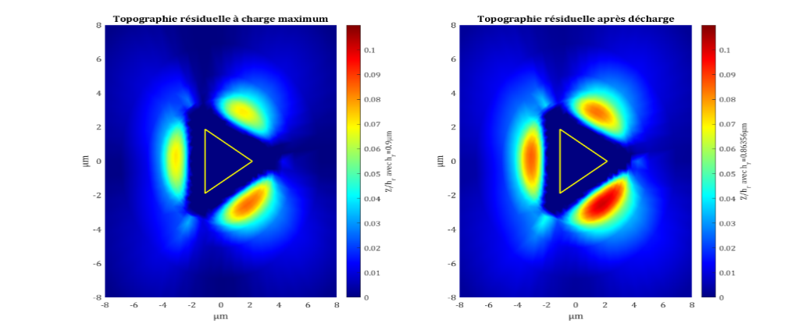
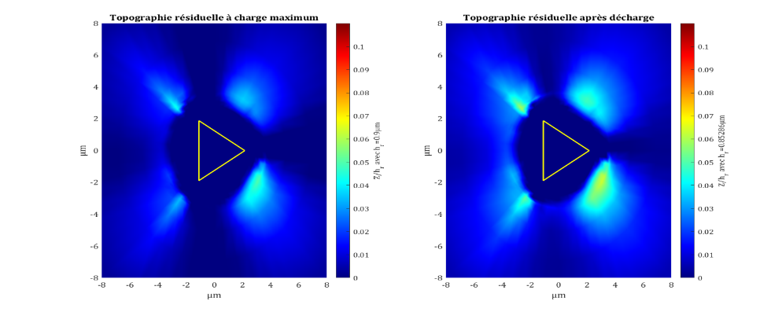
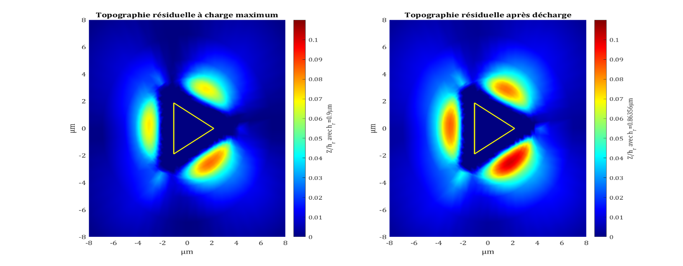
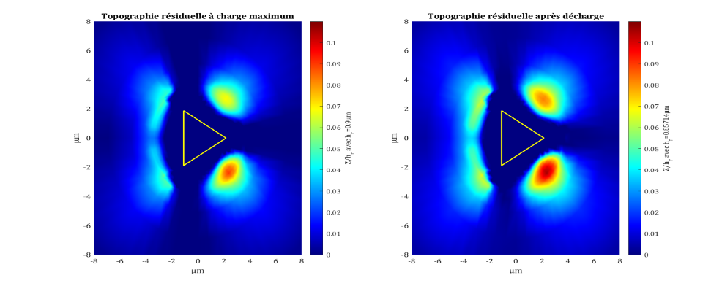

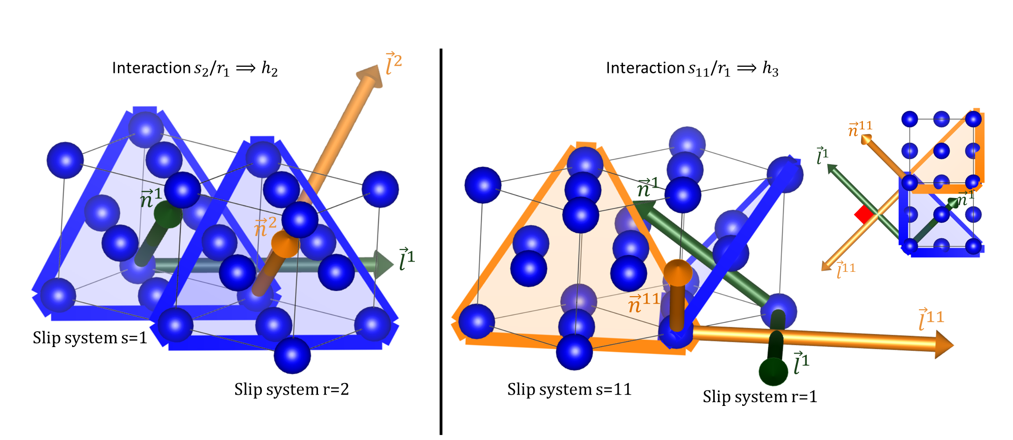
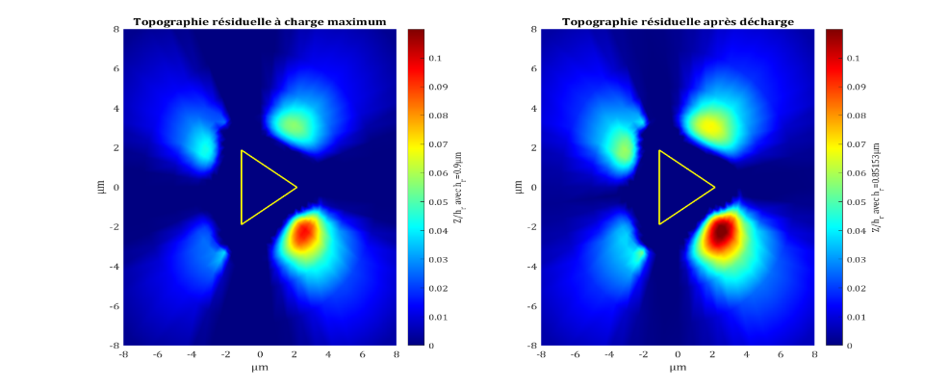
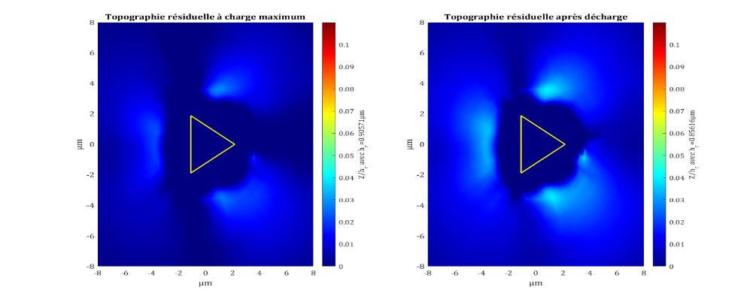










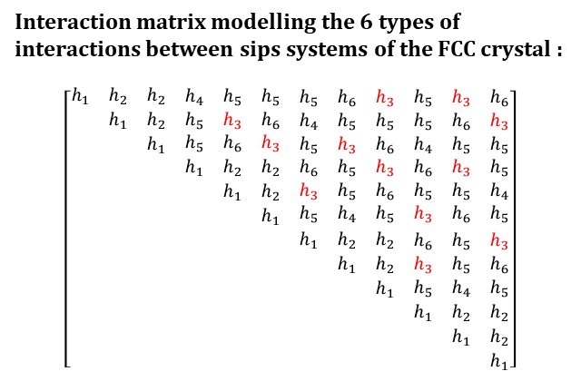



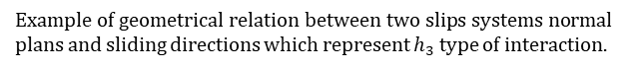
The project target : identify the interaction matrix coefficient using residual indentation topographies, which are really sensitives to those coefficients. Those matrix coefficients characterise the hardening at microscopic scale of the material, taking into account the crystal and is orientation. Each coefficients of the matrix is related to interactions between slips systems of the crystal. This project is concentrated to one material, FCC nickel material, and for FCC crystal there are twelve slips systems and six interactions types.
Interaction matrix modelling the 6 types of interactions between sips systems of the FCC crystal :
$$\left[\begin{matrix}\begin{matrix}\begin{matrix}h_{1} & h_{2} & h_{2} \\ & h_{1} & h_{2} \\ & & h_{1}\end{matrix} & \begin{matrix}h_{4} & h_{5} & h_{5} \\ h_{5} & h_{3} & h_{6} \\ h_{5} & h_{6} & h_{3}\end{matrix} \\ \begin{matrix} & & \\ & & \\ & & \end{matrix} & \begin{matrix}h_{1} & h_{2} & h_{2} \\ & h_{1} & h_{2} \\ & & h_{1}\end{matrix}\end{matrix} & \begin{matrix}\begin{matrix}h_{5} & h_{6} & h_{3} \\ h_{4} & h_{5} & h_{5} \\ h_{5} & h_{3} & h_{6}\end{matrix} & \begin{matrix}h_{5} & h_{3} & h_{6} \\ h_{5} & h_{6} & h_{3} \\ h_{4} & h_{5} & h_{5}\end{matrix} \\ \begin{matrix}h_{6} & h_{5} & h_{3} \\ h_{3} & h_{5} & h_{6} \\ h_{5} & h_{4} & h_{5}\end{matrix} & \begin{matrix}h_{6} & h_{3} & h_{5} \\ h_{5} & h_{5} & h_{4} \\ h_{3} & h_{6} & h_{5}\end{matrix}\end{matrix} \\ \begin{matrix}\begin{matrix} & & \\ & & \\ & & \end{matrix} & \begin{matrix} & & \\ & & \\ & & \end{matrix} \\ \begin{matrix} & & \\ & & \\ & & \end{matrix} & \begin{matrix} & & \\ & & \\ & & \end{matrix}\end{matrix} & \begin{matrix}\begin{matrix}h_{1} & h_{2} & h_{2} \\ & h_{1} & h_{2} \\ & & h_{1}\end{matrix} & \begin{matrix}h_{6} & h_{5} & h_{3} \\ h_{3} & h_{5} & h_{6} \\ h_{5} & h_{4} & h_{5}\end{matrix} \\ \begin{matrix} & & \\ & & \\ & & \end{matrix} & \begin{matrix}h_{1} & h_{2} & h_{2} \\ & h_{1} & h_{2} \\ & & h_{1}\end{matrix}\end{matrix}\end{matrix}\right]$$
Numerical topographies (001)
AFM topographies
$$h_{1}$$
$$h_{2}$$
$$h_{3}$$
$$h_{4}$$
?
Symmetry
$$m_{2}$$
$$m_{3}$$
$$Z/h_{r}$$
$$h_{5}$$
$$h_{6}$$
$$m_{4}$$
$$m_{5}$$
Top view
Example of geometrical relation between two slips systems normal plans and sliding directions which represent $h_{3}$ type of interaction.
$$m_{6}$$
Experimental AFM topographies use to identify the coefficient matrix.
Simulated indentation topographies normalized by the residual indentation depth.
$$m_{7}$$

Slide 4
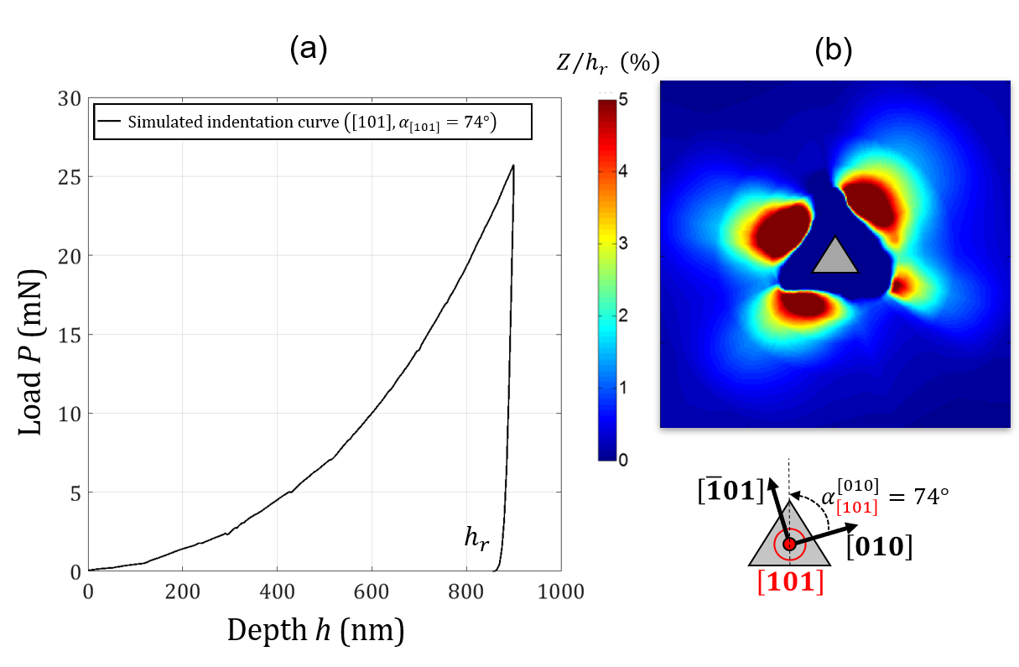
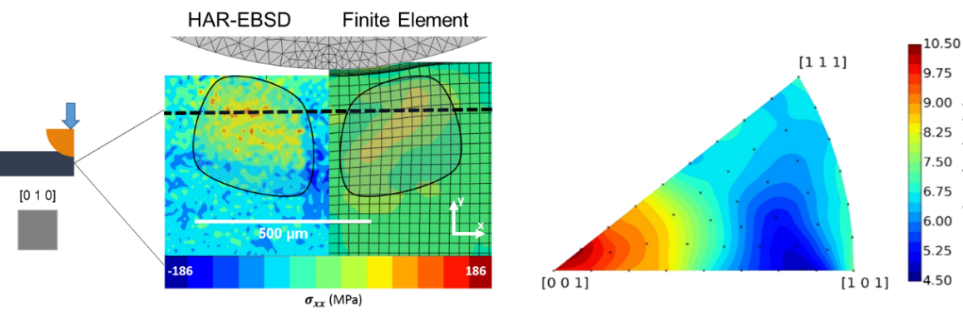
The NOTIFICATION project targets the robust and quick identification of the parameters driving the interaction matrix of a crystal plasticity law using nanoindentation and some associated metrology. The project focuses on pure FCC nickel and copper, but the approach is intended to be applicable to any crystalline material and will be will therefore be tested on nickel-based superalloys.
Left - residual stress measurement over a spherical indentation cross-section using HR EBSD and comparison with CPFEM. Right: effect of crystal orientation (Inverse Pole Figure) on the volume fraction of elements under tensile residual stress
Nanoindentation CPFEM simulation performed in the $\left[101\right]$ grain orientation with azimuth $α$ using a virtual material: (a) indentation curve (b) residual topography
E. Renner, A. Bourceret, Y. Gaillard, F. Amiot, P. Delobelle, F. Richard, 2020. Identifiability of single crystal plasticity parameters from residual topographies in Berkovich nanoindentation on FCC nickel, Journal of the Mechanics and Physics of Solids, vol. 138 , InPress
Breumier, S., Villani, A., Maurice, C., Lévesque, M., Kermouche, G., 2019. Effect of crystal orientation on indentation-induced residual stress field: Simulation and experimental validation. Materials & Design 169, 107659

Slide 5

Les Propositions d’image d’accueil

